Slide 1
Research Report: ML Vision Group
Fei Ding • Apr 18, 2020

Slide 2
Overview
Assigned Task
Find Vision Applications (Names, Suites, Benchmarks)
Progress
Survey of Paper for CV Applications
EAST Text Detection
Tesseract OCR for Text Recognition
Demo
Text Detection in - VM
OCR - Colab Notebook

Slide 3
Progress - Phase 1
CV Application Papers
SLAM
Image Classification
Semantic Segmentation
Text Detection
Comparison
Architecture
Implementation
Performance
Limit

Slide 4
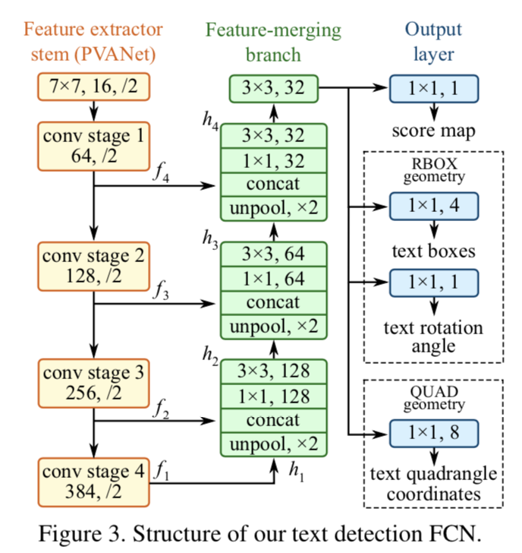
Progress - Phase 2
EAST Text Detection
An efficient and accurate scene text detector
Improvements on current robots with text detection.
Get It to Work
Got it run on Linux (Ubuntu) VM
Good performance, large images

Slide 5
Demo - EAST

Slide 6


Slide 7
Limitations & Improvements
Platform
Ubuntu Linux
Package Version & Dependency
Efficiency
Too Slow
Time proportional to size
GPU

Slide 8
Progress - Phase 3
Tesseract OCR
Optical Character Recognition Engine sponsored by Google
Next step after text detection as to read door tags
Get It to Work
A demo in Google Colab notebook.
Code in Python
Link here

Slide 9
Demo - OCR
In Google Colab

Slide 10
Limitations & Next Steps
Target
Find all texts while only numbers are needed
Contrast, brightness matter
Text too small
Future Work
Smaller images
More dedicated dataset
Pipeline with EAST
GPU & Parallelization

Slide 11
Thank You.

